Slide 1
Three Features of Covid-19
Infection
Disproportionate Effects
Long Covid

Slide 2
Infection vs virulence
Virulence: “the relative capacity of a pathogen (such as a bacterium or virus) to overcome a host's defenses and cause disease or damage”
Contagious: “transmissible by direct or indirect contact with an infected person”

Slide 3
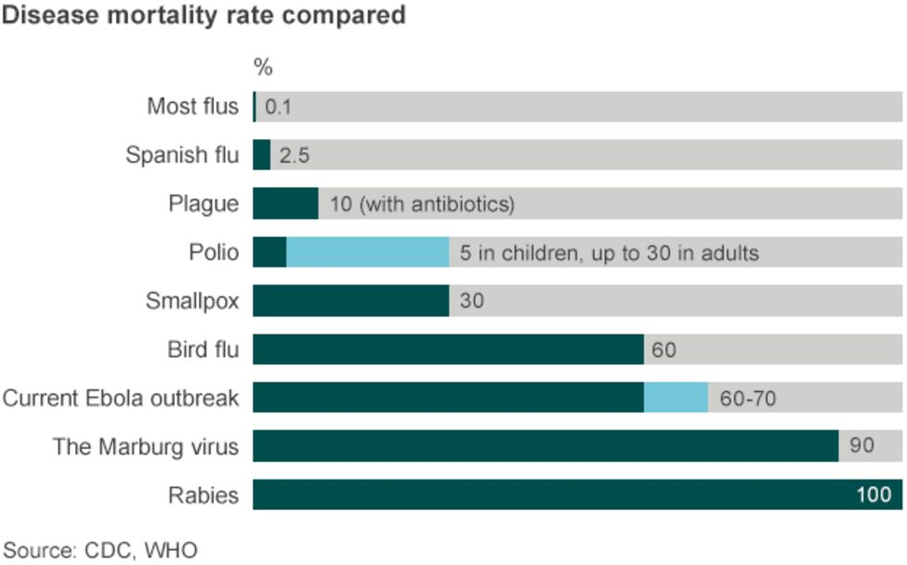

Slide 4
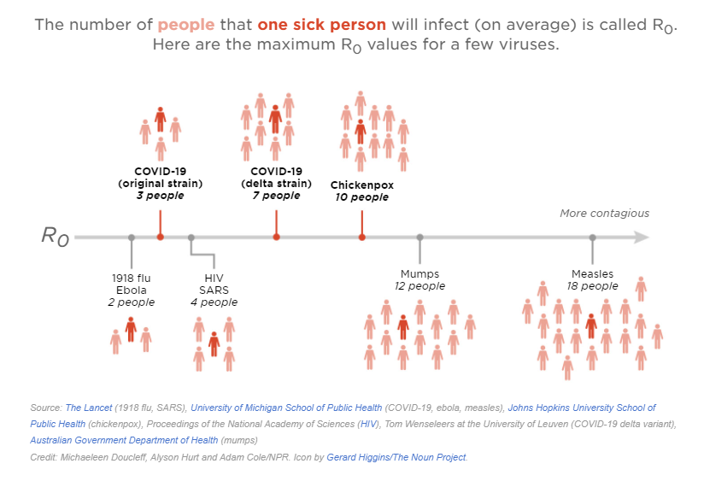

Slide 5
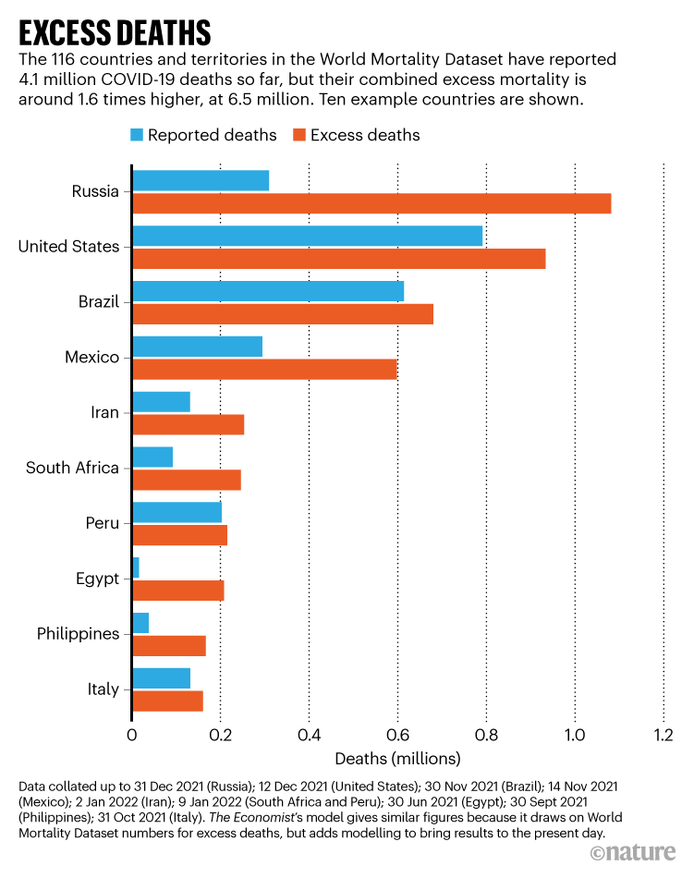
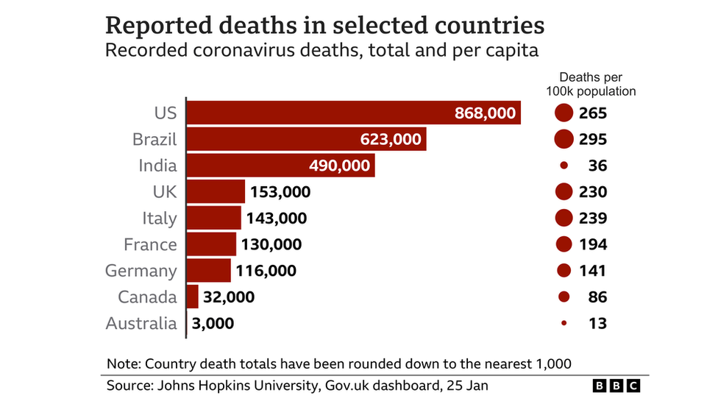
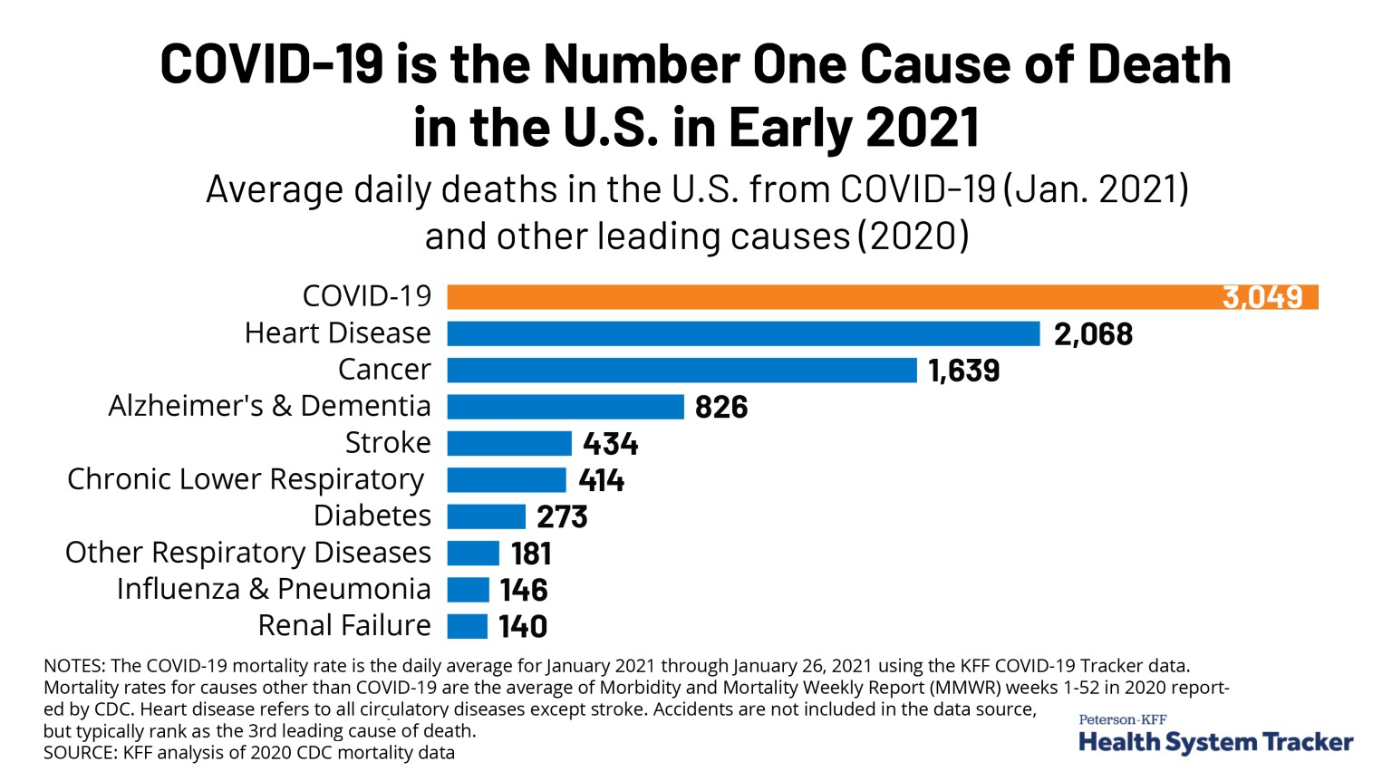

Slide 6
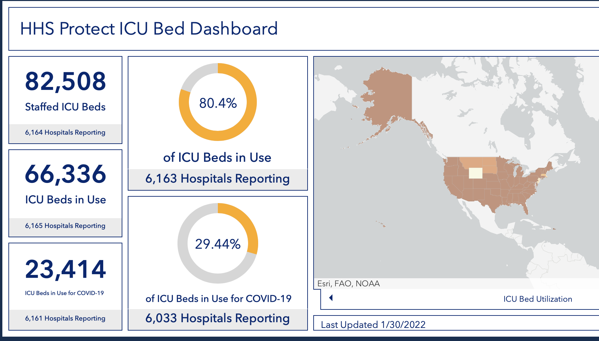
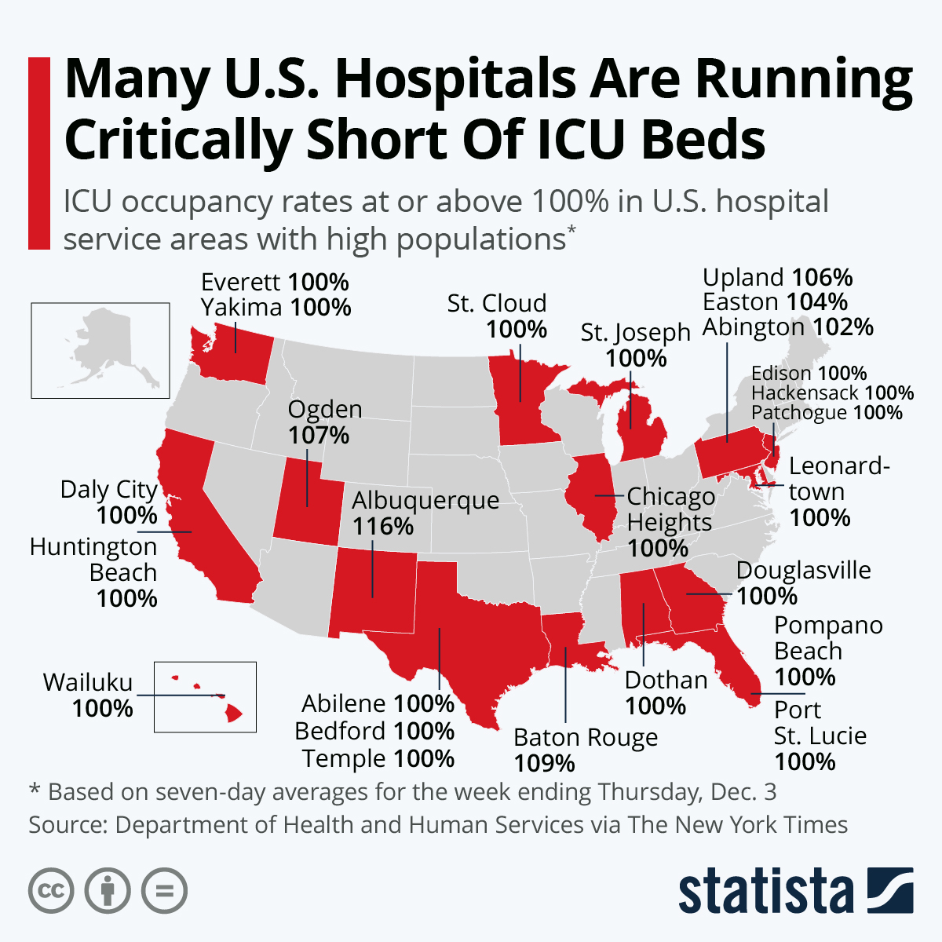


Slide 7
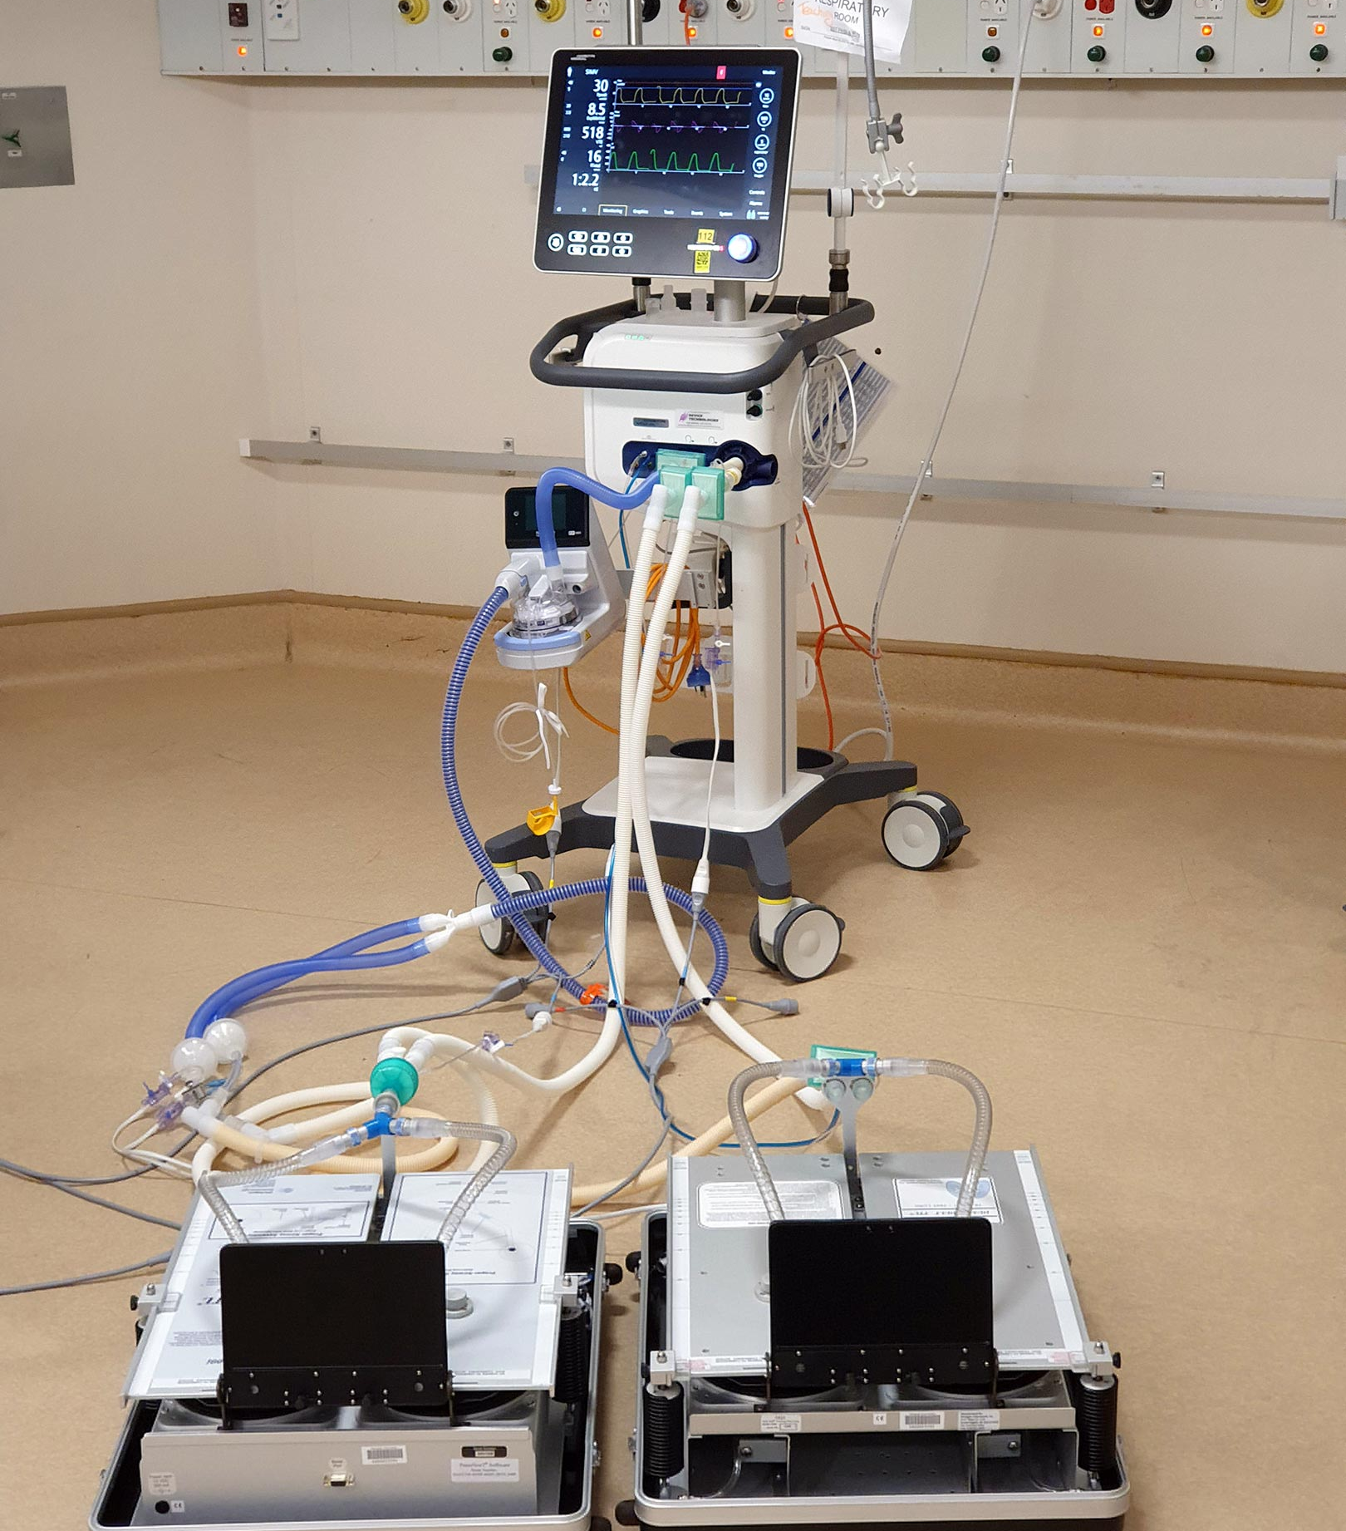



Slide 8
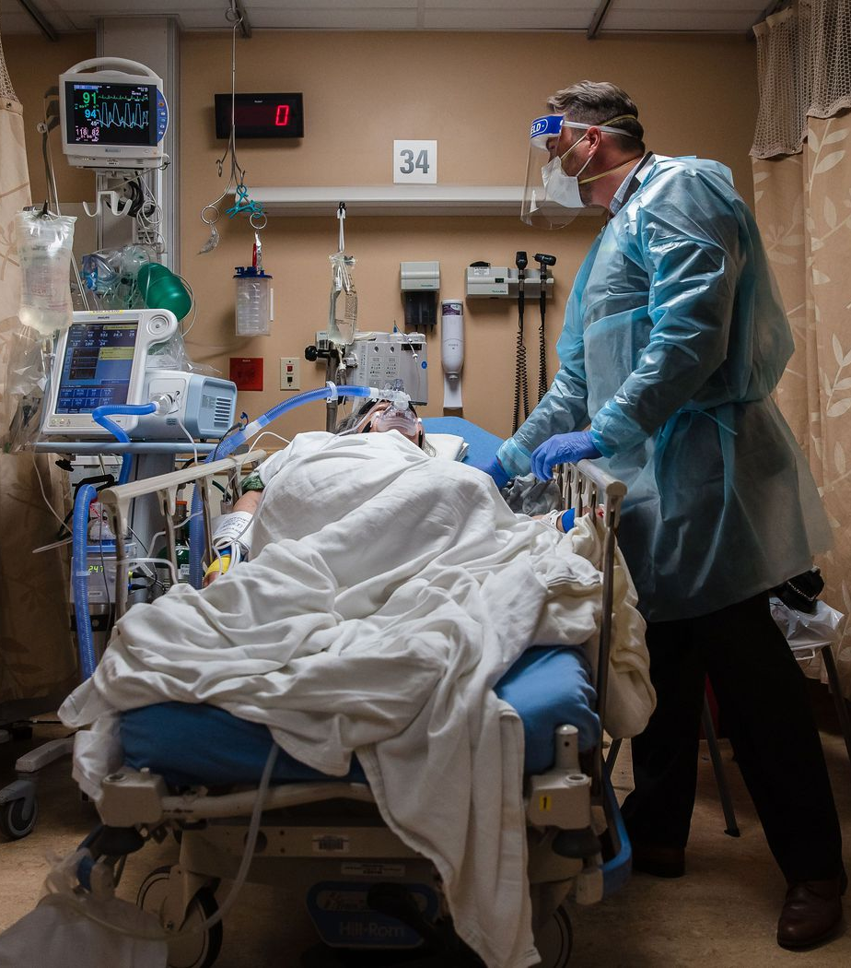



Slide 9
Crisis Standards of Care
https://nbclim-f.akamaihd.net/i/Prod/NBCU_LM_VMS/295/247/DIT_NAT_TOS_NEWS_CRISIS_STANDARDS_OF_CARE_EXPLAINER_2021-01-05_FH__,852972,123175,418263,867033,296693,920860,.mp4.csmil/master.m3u8

Slide 10

Disproportionate Impacts of Covid-19

Slide 11
Total deaths and cases by age group
https://covid.cdc.gov/covid-data-tracker/#demographics
Age Group | Percent of US population | Percent of cases | Percentage of deaths | Count of deaths
0-4 Years | 6 | 3 | <0.1 | 368
5-11 Years | 8.7 | 6.5 | <0.1 | 235
12-15 Years | 5.1 | 4.7 | <0.1 | 274
16-17 Years | 2.5 | 2.8 | <0.1 | 274
18-29 Years | 16.4 | 21.7 | 0.8 | 5,677
30-39 Years | 13.5 | 16.9 | 1.8 | 13,182
40-49 Years | 12.3 | 14.4 | 4 | 29,766
50-64 Years | 19.2 | 18.5 | 17.6 | 131,158
65-74 Years | 9.6 | 6.7 | 22.1 | 164,615
75-84 Years | 4.9 | 3.3 | 26 | 193,171
85+ Years | 2 | 1.7 | 27.5 | 204,845
 | Date generated: Thu Jan 27 2022 20:01:02 GMT-0500 (EST)

Slide 12

Harming children to save society

Slide 13
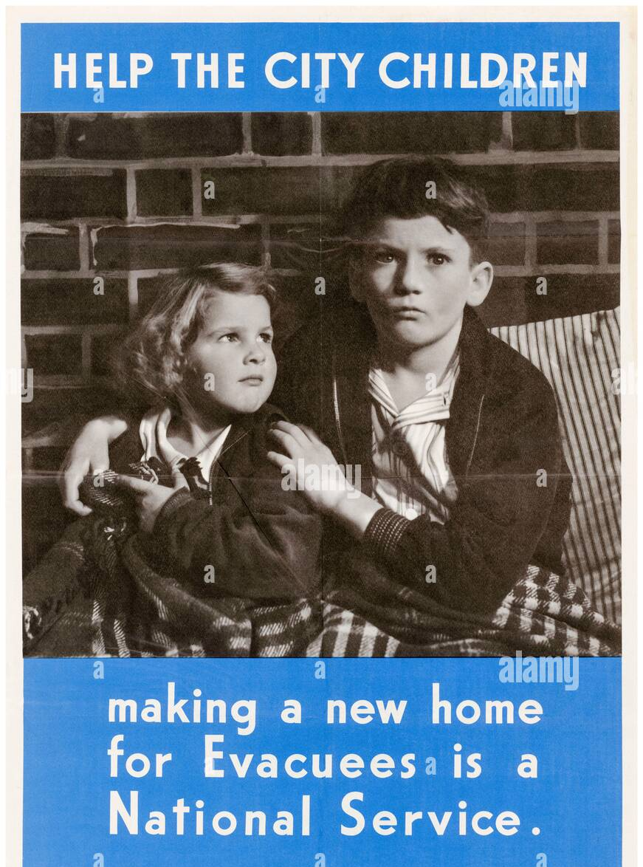



Slide 14
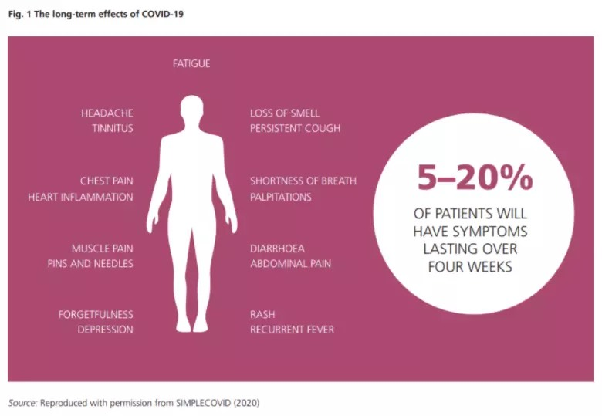
Long Covid

